Slide 1
Automated Code Repair Based on Inferred Specifications
Will Klieber (presenting) Will Snavely
Software Engineering Institute
Carnegie Mellon University
Pittsburgh, PA
IEEE SecDev Conference Nov 3–4, 2016

Slide 2
Copyright 2016 Carnegie Mellon University
This material is based upon work funded and supported by the Department of Defense under Contract No. FA8721-05-C-0003 with Carnegie Mellon University for the operation of the Software Engineering Institute, a federally funded research and development center.
Any opinions, findings and conclusions or recommendations expressed in this material are those of the author(s) and do not necessarily reflect the views of the United States Department of Defense.
NO WARRANTY. THIS CARNEGIE MELLON UNIVERSITY AND SOFTWARE ENGINEERING INSTITUTE MATERIAL IS FURNISHED ON AN “AS-IS” BASIS. CARNEGIE MELLON UNIVERSITY MAKES NO WARRANTIES OF ANY KIND, EITHER EXPRESSED OR IMPLIED, AS TO ANY MATTER INCLUDING, BUT NOT LIMITED TO, WARRANTY OF FITNESS FOR PURPOSE OR MERCHANTABILITY, EXCLUSIVITY, OR RESULTS OBTAINED FROM USE OF THE MATERIAL. CARNEGIE MELLON UNIVERSITY DOES NOT MAKE ANY WARRANTY OF ANY KIND WITH RESPECT TO FREEDOM FROM PATENT, TRADEMARK, OR COPYRIGHT INFRINGEMENT.
[Distribution Statement A] This material has been approved for public release and unlimited distribution. Please see Copyright notice for non-US Government use and distribution.
This material may be reproduced in its entirety, without modification, and freely distributed in written or electronic form without requesting formal permission. Permission is required for any other use. Requests for permission should be directed to the Software Engineering Institute at permission@sei.cmu.edu.
Carnegie Mellon® and CERT® are registered marks of Carnegie Mellon University.
DM-0004180

Slide 3
Automated Code Repair (ACR) – Motivation
Software vulnerabilities constitute a major threat.
A majority arise from common coding errors.
Static analysis tools help, but:
Typically are used late in the development process.
Produce an enormous number of warnings.
The volume of true positives often overwhelms the ability of the development team to fix the code.
Huge amount of legacy code in still in use.
Billions of lines of C code.
Unknown number of security vulnerabilities.
Notes:
Software vulnerabilities constitute a major threat.
There is a huge amount of legacy code still in use, including billions of lines of C code, with an unknown number of security vulnerabilities.
Image source: http://www.bigstockphoto.com/image-132503723

Slide 4
Premises for our work on automated repair
Many security bugs follow common patterns.
E.g., “p = malloc(n * sizeof(T))” where n is attacker-controlled.
Integer overflow ⟹ too little memory gets allocated.
By recognizing such a pattern, it is possible to confidently guess the developer's intention (the inferred specification).
E.g., “Try to allocate enough memory to hold n objects of type T.”
It is possible to repair the code to satisfy this inferred spec.
E.g., check if overflow occurs; if so, simulate malloc failing with ENOMEM.
Other approaches also exist
GenProg (Le Goues et al.) – Genetic algorithm to search for a modification that causes all test cases to give desired behavior.
Notes:
Our work on automated repair is based on three premises.
First, many security bugs follow common patterns. For example, one common pattern is using an attacker-controlled value in a calculation of how much memory to allocate, without checking for integer overflow. This can result in too little memory getting allocated, which sets the stage for a buffer overflow later on.

Slide 5
Outline
Repairs for three types of bugs:
Integer overflow leading to memory corruption. (FY 2016)
Static analysis
Missing memory bounds checks. (FY 2017)
Static analysis and dynamic analysis
Missing authorization checks in a client-server application. (No plans for implementation)
Heavyweight formal methods
Notes:
In this talk, I’ll discuss repairs for three types of bugs.
First, integer overflow leading to memory corruption. We performed this work in fiscal year 2016, and I’ll spend most of my talk on this topic.
Second, missing memory bounds checks. This illustrates using dynamic analysis to complement static analysis. We started working on the Memory Bounds work last month and will continue working on during the remainder of this fiscal year.
Third, missing authorization checks in a client-server application. This illustrates using heavyweight formal method in automated repair.

Slide 6
Integer Overflow
This past year (FY16), we developed techniques for automated repair of integer overflows that lead to memory corruption.
Integers in C are represented by a fixed number of bits N.
Overflow occurs when the result cannot fit in N bits.
Modular arithmetic: Only the least significant N bits are kept.
How does integer overflow lead to memory corruption?
Memory allocation: malloc(∙).
Bounds checks for an array.
Example: Android Stagefright bugs (July 2015).
Notes:
There are two main ways:
The first is integer overflow in the calculation of how much memory to allocate, resulting in a too-small allocation and subsequent out-of-bounds memory access.
The second is integer overflow in the bounds check for an array. This can cause a check that should have failed to instead succeed, allowing an out-of-bounds memory access.
As an example, both of these were present in the Android Stagefright bugs disclosed in July 2015.
--------------------
We repair overflows so that the program behaves the same as if unlimited-bitwidth integers were used.
For unsigned integers, if the result of an overflowing operation is only used in subsequent addition or multiplication (not subtraction or division), then the quantity is monotonically non-decreasing in subsequent arithmetic (except for multiplication by zero). Thus, unlimited-bitwidth arithmetic can be emulated by using saturation arithmetic, i.e., replacing an overflowed value with the greatest representable value (SIZE_MAX for type size_t). If the declared types of variables are smaller than size_t, they are changed to size_t.

Slide 7
Experimental Results
Xi Wang et al., OSDI 2012
 | Overflows reported by Kint | Overflows that are sensitive | Overflows fully repaired | Semi-repair | Unrepaired
OpenSSL | 969 | 233 | 180 | 28 | 25
Jasper | 481 | 101 | 53 | 32 | 16
(1.0.2g)
An overflow is sensitive iff it involves variables associated with array indices or bounds.
Some of the ‘repairs’ are actually false positives (i.e., operation never overflows). Then our ‘repair’ just adds a little overhead. It never breaks working code.
Others are known vulnerabilities with CVEs and patches.
Notes:
OpenSSL includes cryptographic functions where use of modular arithmetic is intentional. Our technique correctly leaves these alone.
Jasper is a library for encoding and decoding JPEG2000 images.
We use a tool called “Kint” to determine which arithmetic operations have the potential for overflow.
We then narrow these down to those that are sensitive, that is, those that are associated with array indices or bounds.
Fully repaired 50% in Jasper, 75% in OpenSSL..

Slide 8
Repair Strategy
Inferred specification: inequality comparisons involving array indices or bounds should behave as in normal arithmetic (not modular arithmetic).
Includes malloc.
Excludes crypto and hashing functions.
“%” operator does not propagate sensitivity.
Repair: General case is intractable (with bounded memory).
Special case that we handle: non-negative integers with only addition or multiplication (no subtraction or division).
The value is monotonically non-decreasing (except for multiplication by zero).
Normal arithmetic can be emulated using saturation arithmetic:
Replace an overflowed value with greatest representable value (SIZE_MAX).
Assumes all values in calculation are of the same type.
Memory-related integers should be of type size_t; promote up if smaller.
Notes:
We repair overflows so that the program behaves the same as if unlimited-bitwidth integers were used.
For unsigned integers, if the result of an overflowing operation is only used in subsequent addition or multiplication (not subtraction or division), then the quantity is monotonically non-decreasing in subsequent arithmetic (except for multiplication by zero). Thus, unlimited-bitwidth arithmetic can be emulated by using saturation arithmetic, i.e., replacing an overflowed value with the greatest representable value (SIZE_MAX for type size_t). If the declared types of variables are smaller than size_t, they are changed to size_t.
This includes malloc, which internally compares the requested amount of memory to the size of the largest unallocated chunk of virtual memory.
Inferred specification: ...
- Includes malloc, which has an internal comparison (requested_mem ≤ available_mem).
- Excludes crypto and hashing functions, which are designed to employ modular arithmetic.

Slide 9
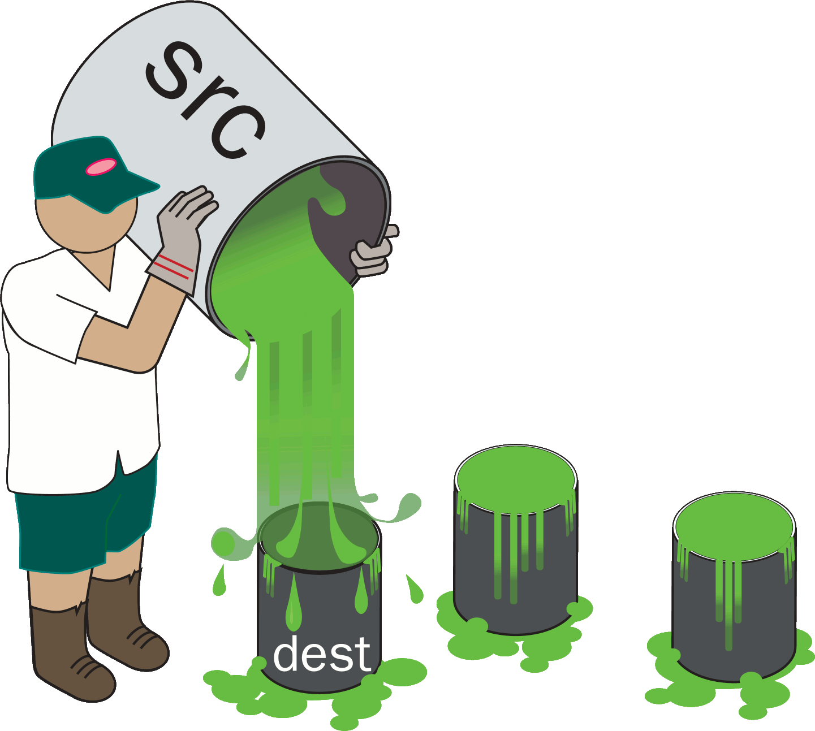
Arithmetic for Checking Bounds of an Array
Example: copy n bytes from src to dest, starting at index start of dest.
Repair: UADD(start, n) /* defined on next slide */
if (start + n <= dest_size) { memcpy(&dest[start], src, n); } else { return -EINVAL; }

Slide 10
wrappers.h
inline static size_t UADD(size_t lop, size_t rop) {
size_t result;
bool flag = __builtin_add_overflow(lop, rop, &result);
if (flag) {result = SIZE_MAX;}
return result;
}
What if dest_size is SIZE_MAX?
What if both sides of inequality overflow?
What if overflow reaches a non-comparison sink?
Repair: UADD(start, n)
if (start + n <= dest_size) { memcpy(&dest[start], src, n); } else { return -EINVAL; }
Notes:
What if dest_size is SIZE_MAX?
That’s actually an impossible situation: it would mean that the destination buffer consumes the entire virtual address space.
What if both sides of inequality overflow?
Then we cannot guarantee that we emulate normal arithmetic, so we issue a warning.
What if overflow reaches another sink (not a comparison)?
Then we cannot guarantee the correctness of our repair, so we issue a warning.
The function __builtin_add_overflow is available in gcc and clang. For a portable solution, an idiom can be used (e.g., lop + rop < lop).

Slide 11
Semi-Repair
Example adapted from CVE-2015-8370:
unsigned cur_len = 0;
while (1) {
key = grub_getkey();
if (key == ‘\b’) {
if (cur_len == 0) {
/* FIXME: Insert error- handling code here. */
}
cur_len--;
grub_printf(“\b”);
continue;
}
if (cur_len + 2 < buf_size) {
buf[cur_len++] = key;
grub_printf(“%c”, key);
}
}
If a potentially overflowed value is used to index into an array, do a semi-repair.
Tool inserts check for overflow. User writes error-handling code.
semi-
repair
Notes:
This code sample is from Grub, a Linux boot loader.

Slide 12
Repair on source vs a compile-time pass
A difficulty we encountered was the Source↔IR mapping problem:
Code is most readily analyzed and repaired on a suitable intermediate representation (IR).
Transformations on the IR aren’t unambiguously mappable to the source.
Macros and #ifdefs are a further difficulty.
We are further investigating these issues this year (FY17).
Notes:
Code is most readily analyzed and repaired on an intermediate representation (IR).
But actual repair must be on the source.

Slide 13
Outline
Integer overflow (7 slides)
Missing memory bounds checks (1 slide)
Missing authorization checks (2 slides)
Notes:
Now I’m done covering integer overflows. Next I’ll cover missing bounds checks, and then missing authorization checks.

Slide 14
Memory Bounds
First propose candidate bounds via static analysis.
Then use dynamic analysis to weed out too-strict candidate bounds:
Instrument program to record which candidate bounds checks fail.
Run the instrumented program to collect presumed-good traces.
Write to log file when bounds checks are violated.
Use test cases and/or run the instrumented program in production.
Reject candidate bounds checks that fail on presumed-good traces.
Using log file from above step
Optional: Manual verification of failed checks
Finally, repair the program to enforce bounds checks (abort() on fail).
Optionally (if user willing to provide manual effort):
Construct ‘malicious’ inputs that would violate the inferred bounds.
Ask the user to confirm that these are indeed bad traces.
Notes:
Then use dynamic analysis to weed out too-strict candidate bounds by seeing what memory is actually accessed on good runs.
First run on test cases. Then run instrumented program in production to make sure of bounds checks before enforcing them in production.

Slide 15
Authorization Checks
Database-backed application runs on a central server, talks to remote clients.
Authorization logic (in, e.g., Ruby or PHP) controls which users have access to which items in the SQL database.
Ordinary testing may fail to reveal gaps.
OWASP 2013-A7 “Missing Function-Level Access Control”. CWE-285.
Our goal is to infer the intended access-control policy of the server application and automatically repair deviations from it.
Inferred specification: desired access-control policy is expressed in the normal interaction between the client and the server (no hand-crafted URLs).
Authenticating information (passwords, login tokens) is treated specially.
Notes:
Database-backed application that runs on a central server and talks to remote clients (such as web browsers, smartphone apps, etc.)
Ordinary testing may fail to reveal gaps in server-side access-control logic.
An attacker may be able to exploit such gaps by creating a malicious client or even simply by entering hand-crafted URLs into the web browser.
This is a frequently-encountered bug and appears on the OWASP list of the top ten web vulnerabilities.
Authenticating information (passwords, login tokens) is treated specially, as described in the paper.
% ==================
% Allow a user to read (or respectively write) a data item if and only if the user can read (or resp. write) the data item using normal interactions of the client.

Slide 16
Authorization Checks
We model the client-server system as a labeled transition system.
A transition from one state to another state encompasses (1) the client sending a request to the server and (2) the server sending back a response to the client.
A transition from a state s to a state s' via a request r is considered a normal interaction iff r is available in the client UI in state s.
Let db_access(r, s) denote a formula in first-order logic (FOL) that identifies the sensitive database accesses performed during processing of request r in state s.
IntendedAccess = (∃r. ∃s. db_access(r, s) ∧ s ∊ Reach ∧ r ∊ UI(s))
AttackerAccess = (∃r_{A}. ∃s. db_access(r_{A}, s) ∧ s ∊ Reach)
Ask FOL solver whether (AttackerAccess ∧ ¬IntendedAccess) is satisfiable. If satisfiable, repair authorization logic for processing request r_{A}.
Notes:
We construct a formula IntendedAccess that identifies the database accesses that are available from the user interface.
We construct another formula AttackerAccess that identifies the all possible database accesses, without being restricted to those available from the user interface.
We then ask a first-order logic solver whether the attacker access exceeds the intended access. If so, the solver returns a satisfying request, and we repair the authorization logic for proessing that request.

Slide 17
Conclusion
Questions?
Automated Code Repair (ACR) is suitable for problems where many bugs follow a common pattern and have a corresponding pattern for repair.
 | Inferred Specification | Repair
Integer overflow | Arithmetic for array bounds or indices should not overflow | Emulate unlimited-bitwidth arithmetic where possible
Memory bounds | Infer desired bounds of memory | Insert missing bounds check, call abort() if the check fails
Access control | Access-control policy inferred from normal interaction of client | Insert authorization checks needed to enforce inferred policy
Contact: Will Klieber
Notes:
Automated Code Repair (ACR) is suitable for problems where many bugs follow a common pattern and have a corresponding pattern for repair.
In this talk, I have discussed three type of bugs suitable for ACR: integer overflow, memory bounds, and access control.
Any questions?
(Don’t read the whole table; just keep it up for people to read during Q&A.)

